Slide 1
Visitor Management

Slide 2



A visitor management system is a solution designed to efficiently handle and monitor visitors within a wide range of facilities such as corporate offices, schools or other facilities. It helps enhance security, streamline administrative processes, improve the visitor experience and ensure compliance in a wide range of industries and facilities.
This application has following key features:
Visitors request creation
Visitors' information capture
Check-in and check-out timings
Email notifications
Introduction

Slide 3
Our understanding of detailed functional requirements, integration systems, and key user personas
Requirement summary
Key User
Roles
Admin
Front Desk Executive
Visitors
Visitor request | Option to raise request for multiple visitors at once Front desk executive to have a list view to see the visitor request for a given date Front desk executive to get the email notification about the request
Visitor’s entry process | Front desk executive can- access all the requests edit the details of visitor if needed take picture of visitor from webcam validate the identity of visitor upload identity document
Visitor Check-in and Check-out | Front desk executive can- capture the entry time of visitor capture the exit time of the visitor check out and mark exit multiple visitor at once add comment while marking the check-out of visitor
NFRs
Email notifications | Email notifications on below triggers (but not limited to) to initiator when check in is done for the visitor to initiator if the checkout is not done after the expected visit duration is ended
Multilingual support | Application can support below languages: English German French Hindi
Data Import/Export | Visitor reports over email, Downloadable Old visitor data can be imported Export Data visitors request in excel Admin can be mailed with list of visitors of month or all
KEY FUNCTIONALITIES
Access control | Integration with access control system to grant temporary permissions to visitors as needed
ID badge printing | Generate visitor badges with relevant information and photo for easy identification
Integrations
Siemens Corporate Directory (SCD)
Azure AD
Email Integration
One SRM
SAP
Legends
Current scope
Future scope
External users
Internal users

Slide 4
Visitor management– Key features (1/2)
Features/Functional Package
High-level description
Completed
Future
Visitor request
Option for employees to create the visitor request where they can enter below information
Name of the visitor
Contact information
Date of visit
Front desk executive to get the email notification about the request.
Front desk executive to have a list view to see the visitor request for a given date
Option to raise request for multiple visitor at once
Visitors entry process
Front desk executive
To have access to all the request
Can edit the details of visitor if needed
Have option to take picture of visitor from webcam
Need to validate the identity of visitor
Have option to upload identity document
Check-in and check-out timings
Front desk executive
Can capture the entry time of visitor
Can capture the exit time of the visitor
Can check out and mark exit multiple visitor at once
Comment option while marking the check-out of visitor

Slide 5
Visitor management– Key features (1/2)
Features/Functional Package
High-level description
Completed
Future
Email notifications
Email notifications on below triggers (but not limited to)
Notification to initiator when check in is done for the visitor
Notification to initiator if the checkout is not done after the expected visit duration is ended.
Multilingual support
Application can support below languages:
English
German
French
Hindi
Data Import/Export
Visitor reports over email, Downloadable
Old visitor data can be imported
Export Data visitors request in excel
Admin can be mailed with list of visitors of month or all.
ID badge printing
Generate visitor badges with relevant information and photo for easy identification
Access control
Integration with access control system to grant temporary permissions to visitors as needed

Slide 6


Architecture Diagram
Mendix Runtime Engine
Application Logic
UI Modules
Login
Security Layer
User Management
Employee Request
Model Driven Development
Request
Visitor management
Import/Export/Mail Data
Domain Model
Browser Access
Request management
Visitor Exit
Nanoflow
Microflow
Integration Layer
Response
Customize theme
Multilanguage support
Integration Layer
Mail Server Integration

Slide 7
Sample mock-up screens

Slide 8
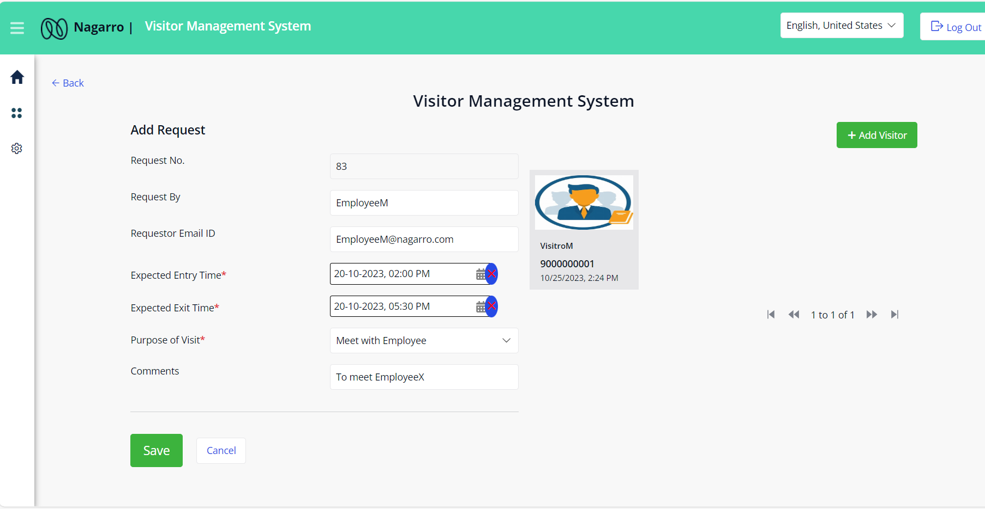
Visitor management system –New Request

Slide 9
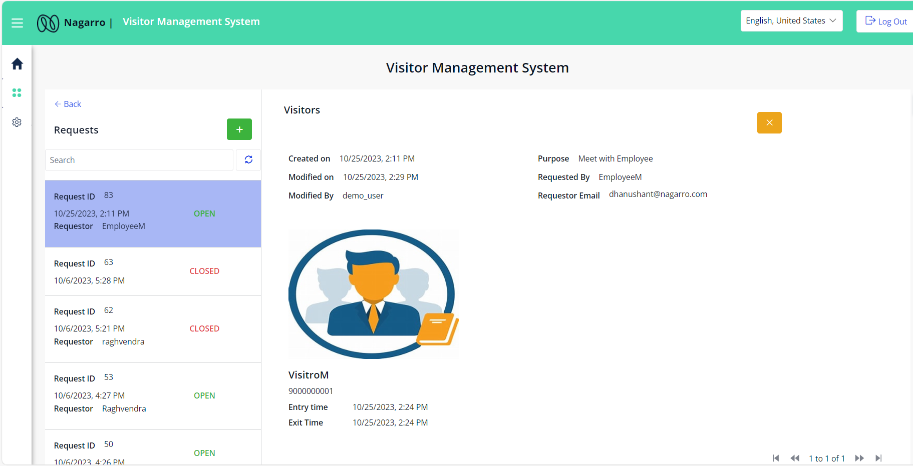
Visitor management system – Request Overview

Slide 10
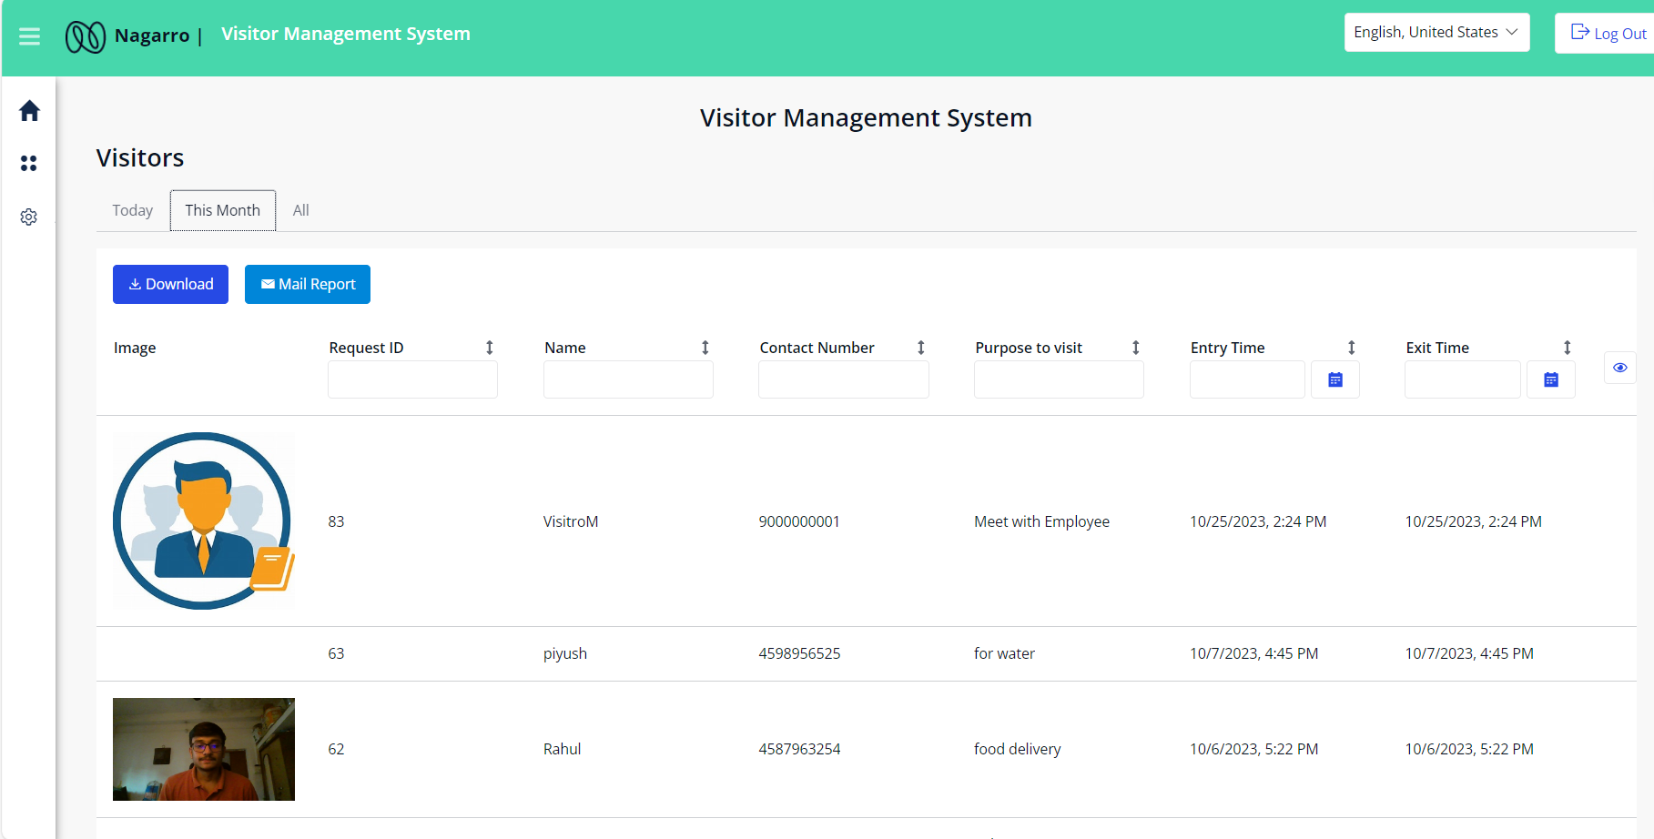

Visitor management system – Visitors Overview

Slide 11
Thank You

Slide 12
Employee can provide information that visitors are expected.
Add New visitors.
Manage all visitors of the application.
Today’s visitor info can be re-edit if filled wrong.
Revisiting visitor details auto fill based on Contact number.
Clicking entry picture of visitor and his identity.
Visitor Photo and document can be uploaded from files as well
A request can have multiple visitors.
Exit All visitor at once.
Exit visitor separately (Marking exit comments).
Visitor reports over email, Downloadable.
Old visitor data can also be imported.
Brand logo and theme can be customized.
Multilanguage support.
Notify the requestor if the visitors exceeded the expected leave time.
Export Data in form of excel.
Send Overall report via email to the respective Admins
Features

Slide 13
Visitor Management system is a portal by which Employee can request for upcoming Visitors. Receptionist can overall manage the entry and exit of visitors. By validating their Identity. With one request there can be multiple visitors which may opt to exit on same time or different time.
Introduction

Slide 14
Architecture Diagram
Mendix Runtime Engine
Application Logic
UI Modules
Login
Security Layer
User Management
Employee Request
Model Driven Development
Request
Visitor management
Import/Export/Mail Data
Domain Model
Browser Access
Request management
Visitor Exit
Nanoflow
Microflow
Integration Layer
Response
Customize theme
Multilanguage support
Integration Layer
Mail Server Integration

